Slide 1
ASSIGNMENT 1

Slide 2
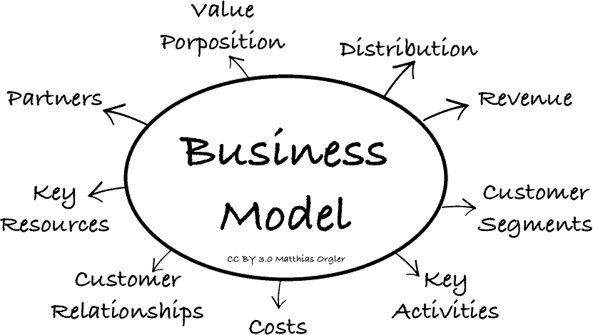
Business
A business is defined as an organization or enterprising entity engaged in commercial, industrial, or professional activities. Businesses can be for
-profit entities, which is on most of the businesses are focused.
-non-profit organizations that operate to full fill a charitable mission or further a social cause.
Businesses most often form after the development of a business
Plan or business idea, which is a formal document detailing a
business's goals and objectives, and its strategies of how it will
achieve the goals and objectives. Business plans are almost
essential when borrowing capital(Loan) to begin operations.

Slide 3
Analysis of 2 shops
Shop 1: Domino’s Pizza
>Open 24/7
>Goggle maps rating: 3.8
>Good Home Delivery service
>Area population : high density
Shop 2: VAGMINE’S PIZZA
>Open 11:00am-10:30pm every day
>Goggle maps rating : 3.9
>No Home Delivery service of its own
>Area population : medium density
Shop 1 and 2 has similar products and prices still shop 1 is able to outperform shop 2!
The reason can be in
1)Location: Shop 1 is located on a busy road which connects resident area to market and couching centres while Shop 2 is located in outskerts of resident area away from market and couching centres.
2)Brand value: Shop 1 is well known international brand implying customers having trust in service and less spectular about hygen.
3)Home Delivery and Ease of parking: These things makes shop 1 more approachable than 2.

Slide 4
IT or Tech sector is the most profitable sector in 5-10 years
The technology sector is comprised of businesses that sell goods and services in electronics, software, computers, artificial intelligence, and other industries related to information technology (IT).
The era of information-driven technology constantly changes the way mankind approaches the corporate world, particularly in doing business transactions, the continuous advancement of other information technology sub-fields such as multimedia and programming, are considered to be the ones responsible for the success of big companies like Microsoft, Apple and Intel. Nowadays, social media networking sites like Facebook has opened new doors for the innovation of Information Technology. Aside from this, a number of sites all over the world promote businesses by offering web-related services such as Web Developing and Search Engine Optimization.
Numbers of computer sold around the world is increasing.

Slide 5
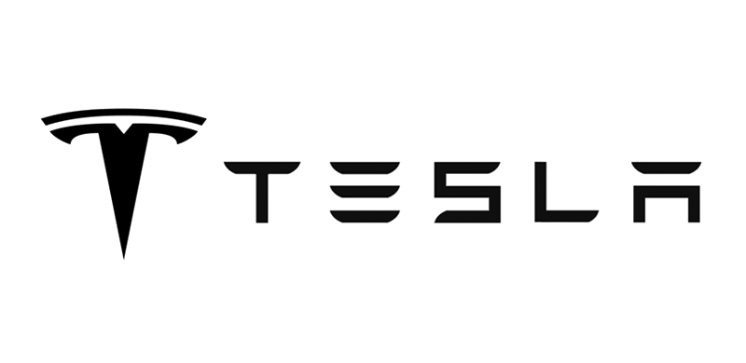


• Founded in Silicon Valley in 2003
• Want to prove that electric cars could be better than gasoline-powered cars.
• Company name is coming from Nikola Tesla who is one of my favourite scientist and is a famous engineer and inventor of AC, induction engines and many more things.
• One of the best reason tesla is growing is because of its mission to move from “mine & burn hydrocarbon” economy to a more sustainable source like a solar electic economy.

Slide 6
I’d rather be optimistic and wrong than pessimistic and right.
Elon Musk

Slide 7
Facts check on Tesla
Profitable
Stocks of Tesla are termed high-valuation, as its price-earnings ratio (P/E ratio) is higher than other companies in its industry.
Capital intensive
Yes, Tesla is a capital intensive as large amount of goods are required to make cars and energy storage products.
Scalable
Tesla focus more on quality than quantity of its production, and with positive demand even in pandemic, it will be difficult to increase production.

Slide 8
Facts check
Barriers to entry in this field
• Being a new field made difficult to get skilled workers.
• Tesla Motors has overcome many barriers by being a pioneer in electric cars.
why customers should choose Tesla
• All-electric means no gasoline or annual maintenance check-ups to deal with.
• Autopilot technology
• Eco-friendly
Competitors
• Most of the Tesla’s Competitors are experienced in car industry more than 50 years. They have world-wide reputation.
• But, they cannot reach the Tesla’s technology level in EV industry.

Slide 9
Facts check
Cost of bring new customers & Future of the market
Tesla is boasting about its $0 marketing budget, but in fact Tesla does spend some money on marketing; but it spends considerably less than its competition. For example, Tesla spent $58.3 million on marketing costs in 2015, while Audi and BMW spent $195 million and $196.6 million respectively.
Yes, electric vehicles have a very good future. Tesla has already reached to this phase of only electric while other big car companies are staring to turn now. Charging stations are being put up along side gasoline feeling stations. Efficient batteries are being manufactured. Due to considered depletion of non- renewable resources, electric cars are being marketed. Hence, it does hold a good future.

Slide 10
Marketing strategy for Tesla
Tesla already has and boast about its “$0 marketing budget”.
Which has worked great as per many experts.
In India however it won’t be working as there are already many Expensive and Luxury car companies established ,marketing Tesla as a Eco-friendly Luxury and modern car will definitely shift the customers to get a Tesla. Here ‘Modern’ and ‘Next Generation’ should be the key words.

Slide 11
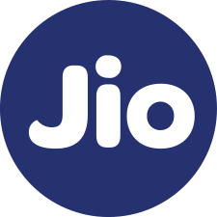
Reliance Jio
As from a consumer perspective jio was a great startup and an initiative .
• Reliance’s vision for India was that broadband and digital services should no longer be a luxury item ,Rather convert it into a basic necessity that can be consumed in abundance by consumers and small businesses .The initiatives are truly aligned with the Government of India's ‘Digital India’ vision for our nation.
• Affordable Devices
• Digital Education
• Digital Currency
• Digital Entertainment and social connectivity
• Free welcome offers

Slide 12
Facts check
Profitable
Jio isn't listed on any stock exchange. Investing can be done in its parent company Reliance Industries.
Yes, Reliance is very profitable for investing with a current PE ratio of 20.41 .
Capital intensive
Jio is capital intensive as it requires an extensive network infrastructure to provide fixed line and wireless services.
Scalable
Yes, Jio has proved its by
Providing service to 400 million+ customers in 2020.

Slide 13
Facts check
Barriers to entry in this field
The major barrier for Jio was to gain customers who are being provided really good telecom services already from companies like Airtel , Vodafone etc. Jio needed to gain those satisfied customers. Provide them with something even better and profitable for the customers. Jio provided its customers with a unique and a more affordable solution that the existing companies had. It provided the customers with free internet , just by only buying the sim, free calling, SMS etc. which was only provided by Jio at that time , this tactic was used to increase the customers and break the market of big companies like Airtel. The customers started buying it's services in huge numbers.
Why customers should choose Jio
There are currently 4 Pan India mobile service providers- Jio, Airtel, Vodafone Idea and BSNL. Out these four, Airtel and Vodafone Idea have 2G, 3G and 4G network . BSNL has only 2G and 3G network across India but Jio has only 4G network across India and its coverage is very good covering almost 90 % of Indian population in cities, towns, small towns and villages.

Slide 14
Facts check
Cost of bring new customers & Future of the market
As with the funding from its parent company, Jio was able to give its all new customers with free internet service and unlimited calls by just getting a Jio sim and becoming a customer. Later by charging for there services it recovered all its loans and is now in huge profit.
The future for telecom industry looks very promising and specially in times of covid.
Competitors
With the launch of Reliance Jio , market shares of other major telcos like Airtel, Vodafone, Idea have been falling abruptly.
The unlimited offers of Jio and its boosting trend have made other major telecom service providers to re-think about their tariffs. And to step with this intensifying volume of rivalry and drive users.

Slide 15
Thank You!
By Ganesh Mahalawat
200368

